Slide 1
Portable Electroluminescence Measurement Device Prototype Documentation
Team Solar

Slide 2
Prototype 1

Slide 3
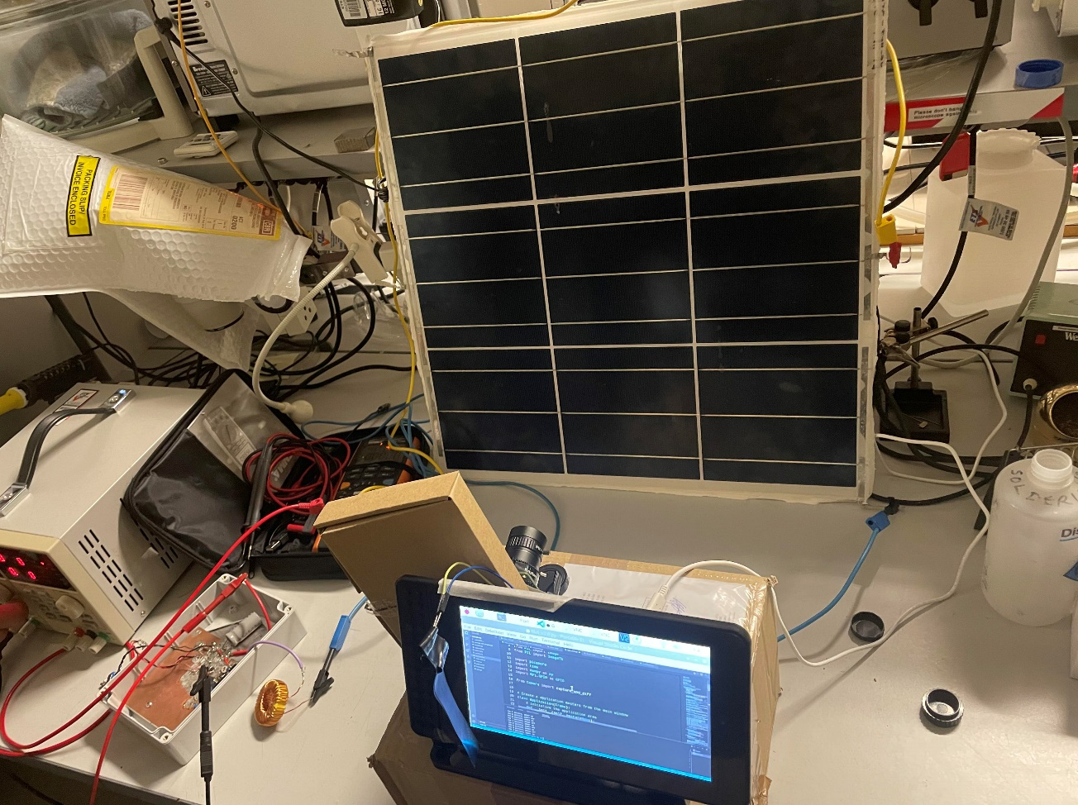
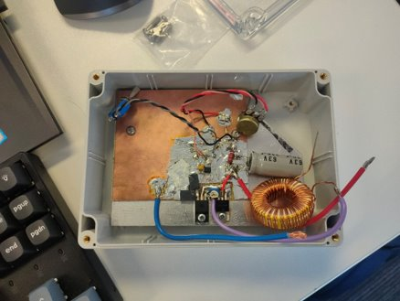
Prototype 1 Subsystems
Camera System
Current Regulator

Slide 4
Prototype 1 Demonstration
Video removed due to size

Slide 5
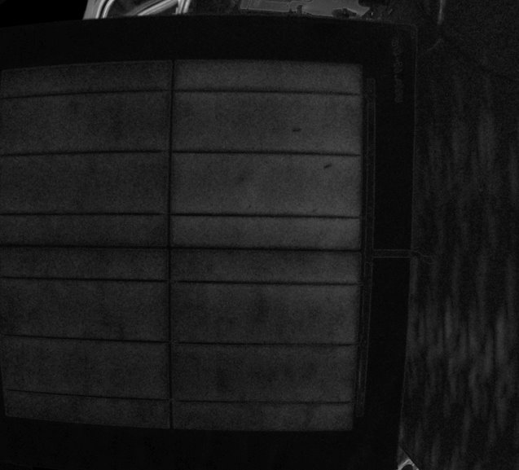
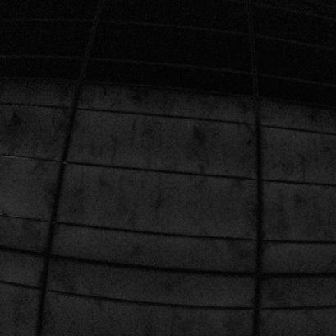
Prototype 1 Results
No power, no EL
Power present, EL produced
EL image of 4 cell solar panel
Validated EL results through partial powering of 9 cell panel

Slide 6
Prototype 1 Key Features
Functional Individual Subsystems
Camera Algorithm on Raspberry Pi able to properly time image capture and perform computer vision transformation (minus two image and average over multiple pairs)
Raspberry Pi display functional and able to display results
Current Regulator able to range current that passes to the panel from 0A to 10A using a potentiometer
Able to obtain EL image using 10 pairs of images within 3 minutes
Validated results using 9 cell solar panel by partial powering of the panel and comparing the cells in the image produced.

Slide 7
Prototype 1 Concerns
Current regulator step up and step down is a manual process, not controlled by Raspberry Pi
Current regulator requires multimeter to indicate current to panel
Current regulator housing container too small to implement wireless RF link
LED light used to indicate when current is being sent to panel introduces noise to the EL image and affects results
Control algorithm runs via code as opposed to on the user interface, therefore requires laptop to operate
Too low camera exposure time, cannot go above 0.1s
Better camera lens not used due to issues with focal length
Camera not stable due to resting on a box

Slide 8
Prototype 2

Slide 9
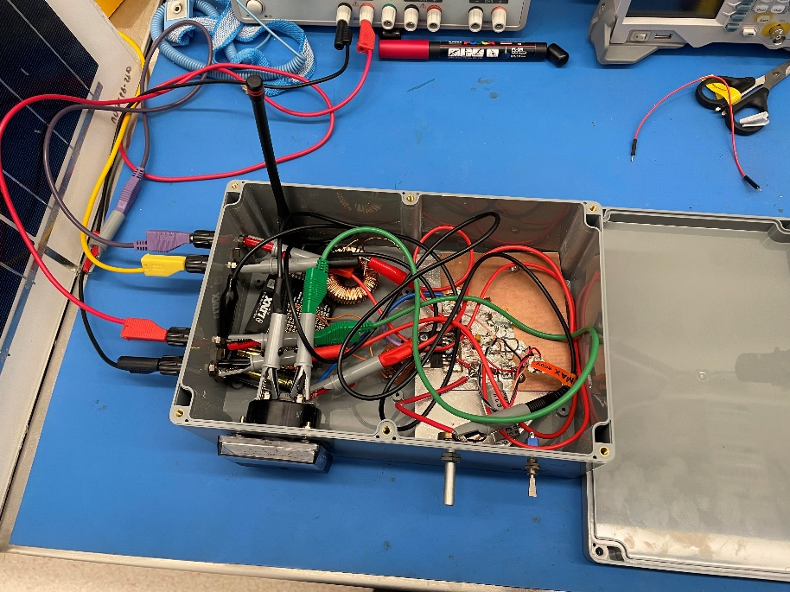
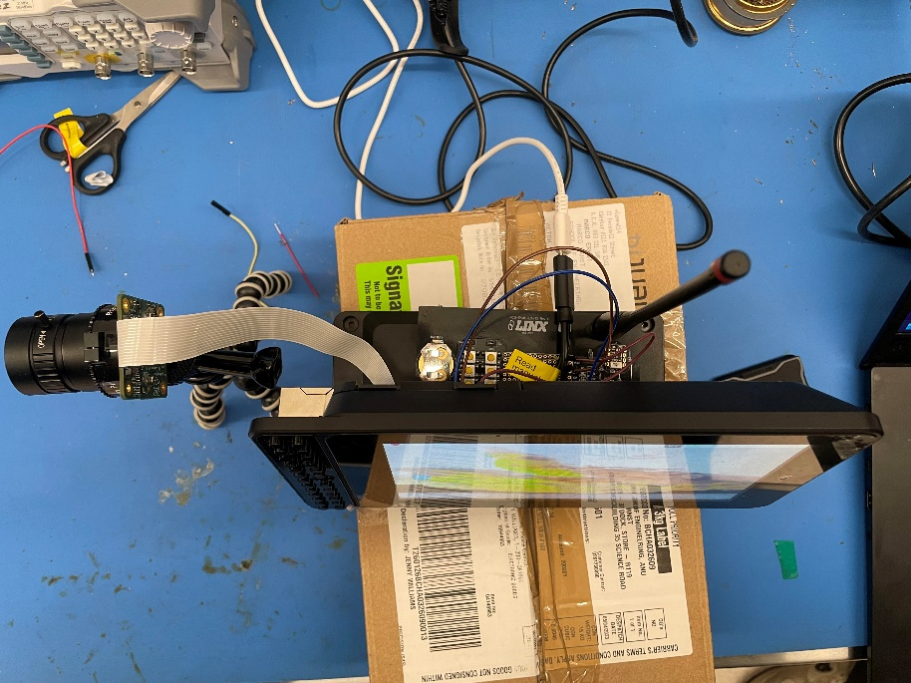
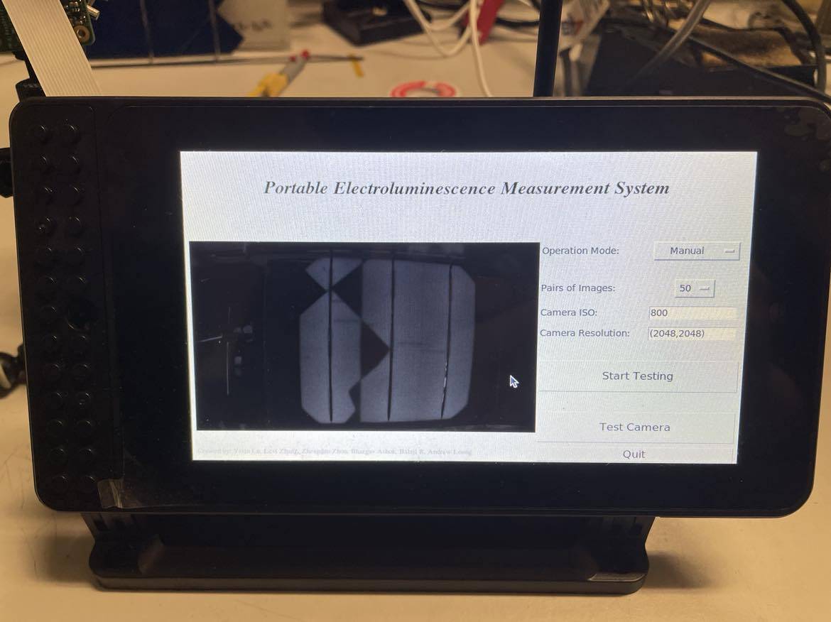
Prototype 2 Subsystems
Current Regulator with RF link, ampmeter, external cable plugs, switch and potentiometer
Camera System with RF trigger
User Interface

Slide 10
Prototype 2 Demonstration
Video removed due to size

Slide 11
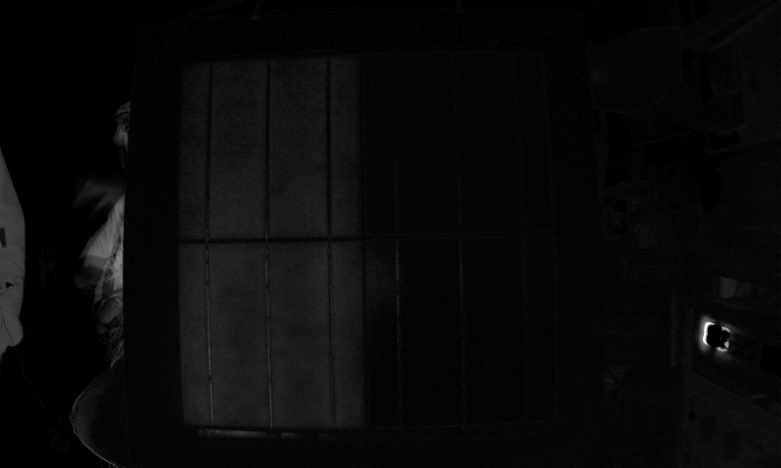
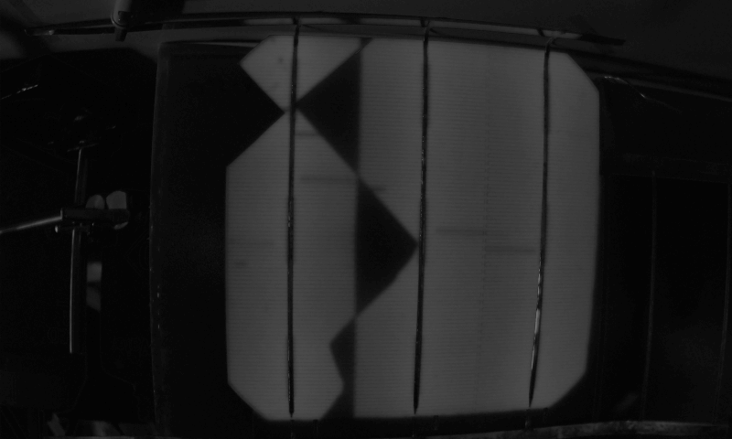
Prototype 2 Results
Power on
Power off
EL result and validation through partial powering of panel
EL image of known broken cell. Highlights cracks and non-functional arms. Validates system results

Slide 12
Prototype 2 Key Features
Functional Individual Subsystems
Raspberry Pi controls timing of both image capture and current regulator using radio frequency, camera now placed on tripod for stability
Algorithm controllable via user interface, no laptop required
Current regulator fitted into appropriately sized box with RF link, built in ampmeter, switch and potentiometer.
Able to obtain EL images using 50 pairs of images within 3 minutes
Validated results using a known broken cell
LED light replaced with buzzer to indicate when current is passed to panel. Reduces noise from LED

Slide 13
Prototype 2 Concerns
Exposure time of camera still too low, cannot go above 0.1s
Better camera still not used due to issues with focal length
System can be optimised to take pictures faster as exposure time is 0.1s but wait time for next image is 1 second.
Image export from user interface to laptop identified. Image captured at 2K resolution but exports at 480p.
Image taken at 8Mpixels as opposed to 12Mpixels allowed for by camera

